Slide 1
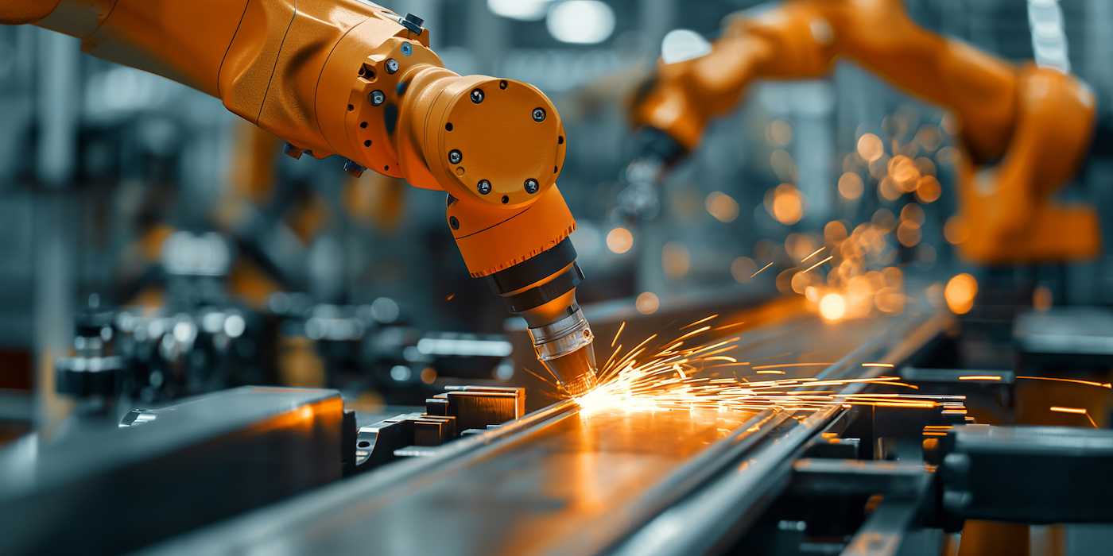

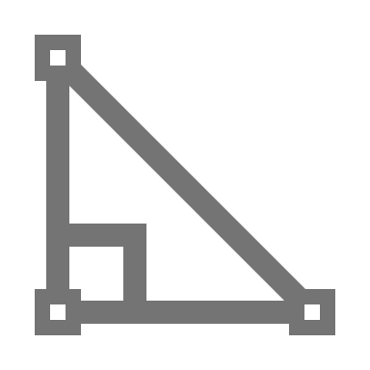

Where It's Used: many areas, such as building vehicles, power plants, and developing energy solutions.
Key Skills: Mechanical engineers use math and science to solve problems and design new things.
What It Is: Mechanical engineering involves making and testing machines that move.

Slide 2
What It Is: Mechanical engineering involves making and testing machines that move.
Key Skills: Mechanical engineers use math and science to solve problems and design new things.
Where It's Used: many areas, such as building vehicles, power plants, and developing energy solutions.

Slide 3
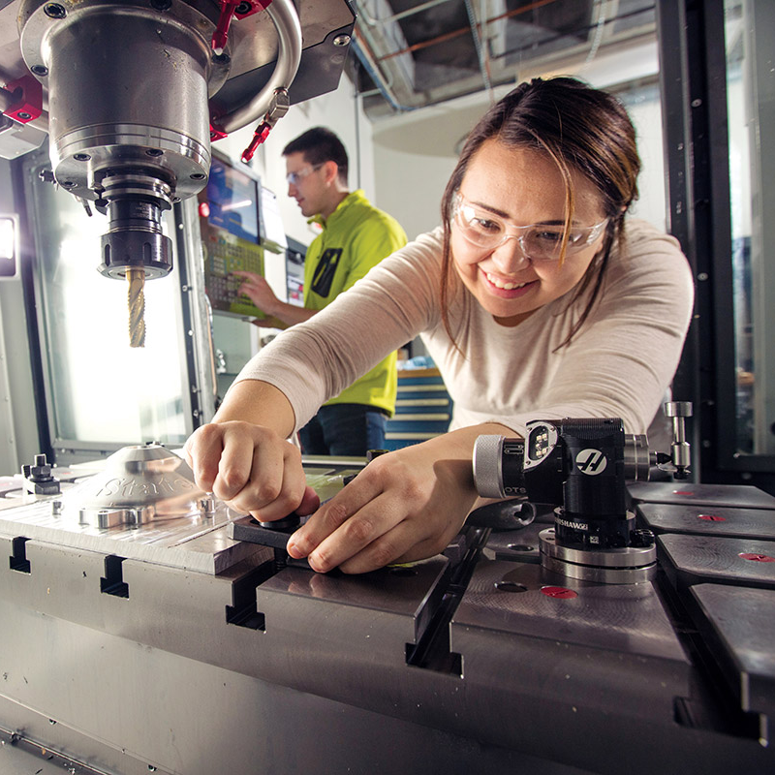
What It Is: Mechanical engineering involves making and testing machines that move.
Key Skills: Mechanical engineers use math and science to solve problems and design new things.
Where It's Used: many areas, such as building vehicles, power plants, and developing energy solutions.
Mechanical Engineering
What Do Mechanical Engineers Do?
Mechanical Engineers:
Design: machines and devices like cars, robots, and engines – all of which have moving parts.
Test: machines to see if they work well, then improve them to make them safer, faster, or more efficient.
Fix: mechanical problems and find ways to make things work better.

Slide 4
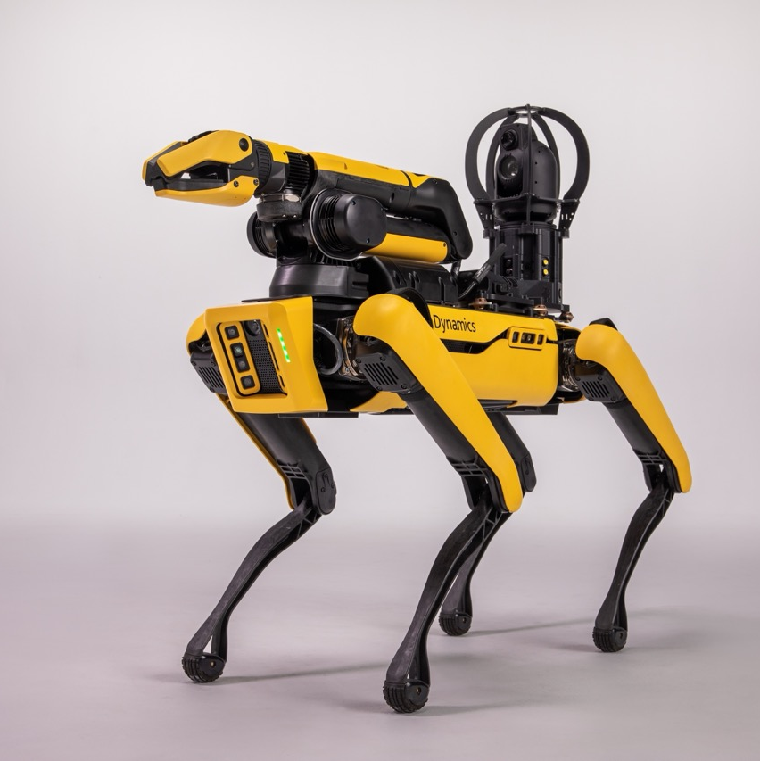
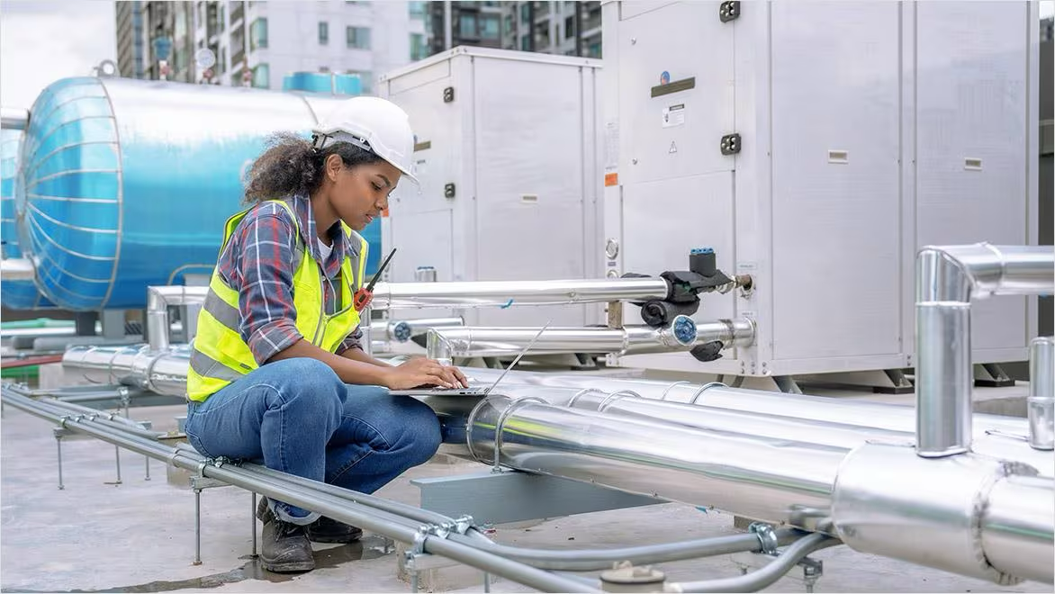
Mechanical Engineering
Mechanical Engineering
Fields
Robotics
Robotics engineers design and build robots and automated systems that can perform tasks in industries like manufacturing and healthcare.

Slide 5
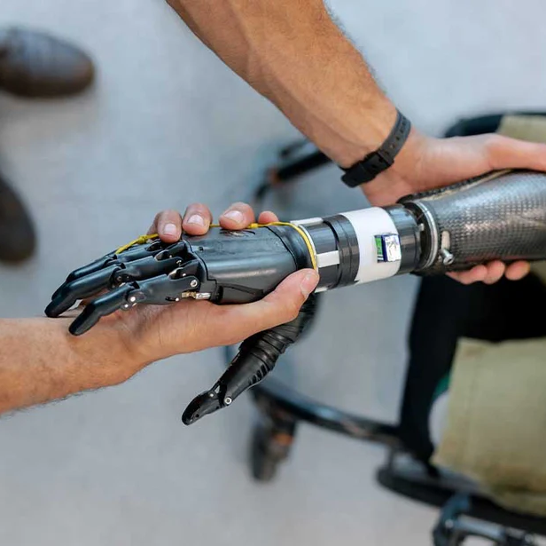
Mechanical Engineering
Mechanical Engineering
Fields
Automotive
Automotive engineers design, develop, and improve vehicles, including cars, trucks, and electric vehicles, focusing on efficiency, safety, and performance

Slide 6
Mechanical Engineering
Mechanical Engineering
Fields
HVAC
HVAC (Heating, Ventilation, and Air Conditioning) engineers create systems that regulate temperature and air quality in buildings to improve comfort and energy efficiency.

Slide 7
Mechanical Engineering
Mechanical Engineering
Fields
Biomechanics
Biomechanics engineers apply mechanical principles to the human body, developing prosthetics, medical devices, and equipment to enhance healthcare solutions.

Slide 8

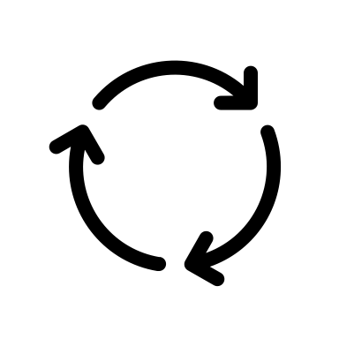



What It Is: Mechanical engineering involves making and testing machines that move.
Key Skills: Mechanical engineers use math and science to solve problems and design new things.
Where It's Used: many areas, such as building vehicles, power plants, and developing energy solutions.
Mechanical Engineering
Engineering Design Process
Define
The Problem
Improve
Brainstorm
Mechanical engineers often use the engineering design process to solve problems
Let’s look at an example!
A team is tasked with designing a more efficient and comfortable wheelchair for people with disabilities.
Define:
Brainstorm:
Prototype:
Test:
Improve:
Your Solution
Solutions
Current wheelchairs are not comfortable
Test
Prototype
Use different seats or add power assist
Create the first version of the new chair
Your Prototype
Your Solution
Get people to test the chair and see if its better
Use the feedback from testing to make changes

Slide 9
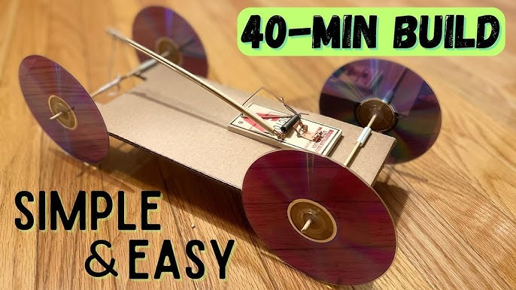
What It Is: Mechanical engineering involves making and testing machines that move.
Key Skills: Mechanical engineers use math and science to solve problems and design new things.
Where It's Used: many areas, such as building vehicles, power plants, and developing energy solutions.
Mechanical Engineering
Mousetrap Car
Project
Your goal is to build a car that is powered by a mousetrap, to go as far as possible.
Materials:
1 Mousetrap
Cardboard
4 Dowels
1 Straw
4 Wheels (CDs or Cardboard)
String
Final Product Example:

Slide 10
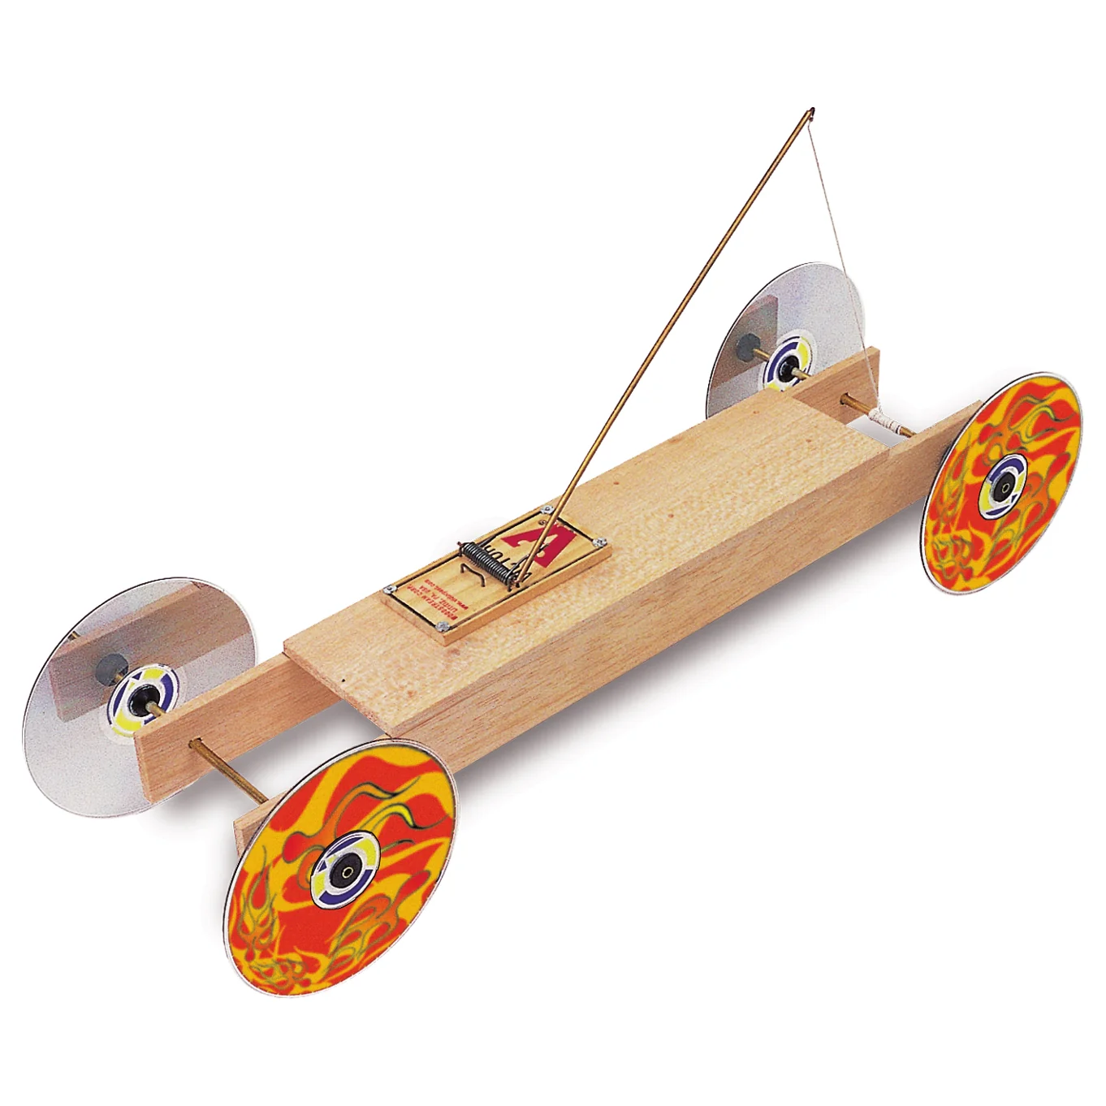

What It Is: Mechanical engineering involves making and testing machines that move.
Key Skills: Mechanical engineers use math and science to solve problems and design new things.
Where It's Used: many areas, such as building vehicles, power plants, and developing energy solutions.
Mechanical Engineering
Mousetrap Car
Design
Basic Design:
Attach a string to the mousetrap’s lever arm.
When the mousetrap is released, it pulls the string attached to the drive axle, causing the wheels to rotate.

Slide 11
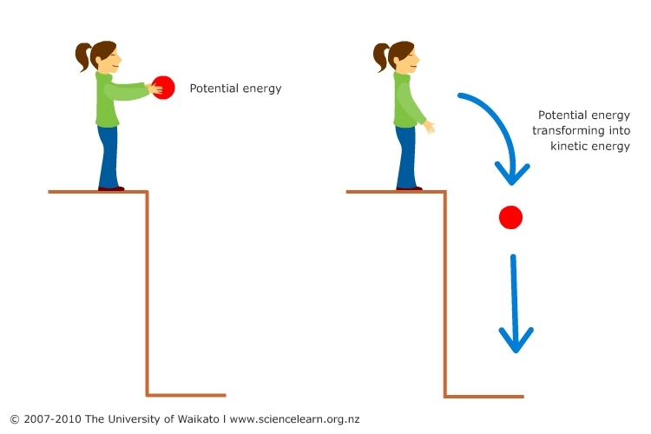
What It Is: Mechanical engineering involves making and testing machines that move.
Key Skills: Mechanical engineers use math and science to solve problems and design new things.
Where It's Used: many areas, such as building vehicles, power plants, and developing energy solutions.
Mechanical Engineering
Energy
Potential Energy: Is the energy stored in an object due to its position or condition. For example, a ball held at a height has gravitational potential energy because of its position above the ground.
Kinetic Energy: Is the energy of motion. An object in motion, such as a falling ball or a moving car, has kinetic energy.
Total Energy: Is the sum of all forms of energy present in a system, which includes both kinetic energy and potential energy.
Joule: International unit for energy. It takes 1 joule to lift a medium-sized tomato about one meter!

Slide 12
What It Is: Mechanical engineering involves making and testing machines that move.
Key Skills: Mechanical engineers use math and science to solve problems and design new things.
Where It's Used: many areas, such as building vehicles, power plants, and developing energy solutions.
Mechanical Engineering
Energy
You may be asking what makes the mouse trap car move
Potential Energy: When the mousetrap is set, energy is stored in the spring, creating potential energy.
Kinetic Energy: Once the mousetrap snaps, the stored energy is released and converted into kinetic energy, which moves the car.

Slide 13
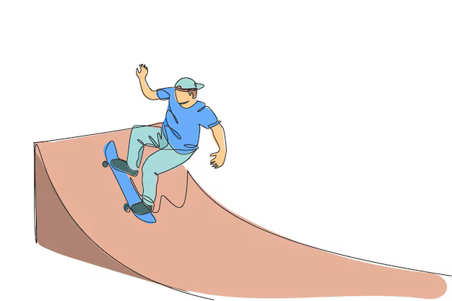
What It Is: Mechanical engineering involves making and testing machines that move.
Key Skills: Mechanical engineers use math and science to solve problems and design new things.
Where It's Used: many areas, such as building vehicles, power plants, and developing energy solutions.
Mechanical Engineering
Energy
Before we continue let’s make sure we understand energy.
A skateboarder is halfway down a ramp. At this point, the skateboarder has 100 joules of potential energy and 300 joules of total energy. What is the skateboarder’s kinetic energy at this point?
Remember! Total Energy = Kinetic + Potential

Slide 14
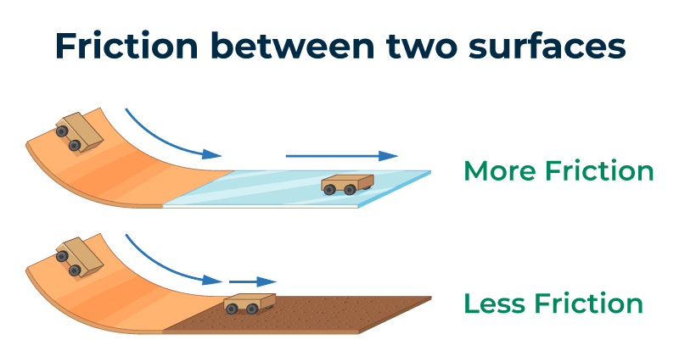
What It Is: Mechanical engineering involves making and testing machines that move.
Key Skills: Mechanical engineers use math and science to solve problems and design new things.
Where It's Used: many areas, such as building vehicles, power plants, and developing energy solutions.
Mechanical Engineering
What Will Happen?
Trying to make a mouse trap car go as far as possible can be rather difficult!
Let's look at a few examples of design changes and how it might affect your car
Let’s first think about friction. What is friction?
Friction is a force that resists the sliding or rolling of one solid object over another.
How does this affect the mouse trap car?
Inside the classroom the floor is carpet
In the hallway the floor is tile
In the gym the floor is wood
Which one has the most friction?

Slide 15
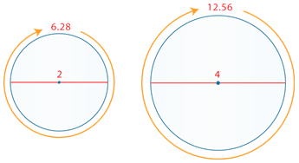
What It Is: Mechanical engineering involves making and testing machines that move.
Key Skills: Mechanical engineers use math and science to solve problems and design new things.
Where It's Used: many areas, such as building vehicles, power plants, and developing energy solutions.
Mechanical Engineering
What Will Happen?
Trying to make a mouse trap car go as far as possible can be rather difficult!
Let's look at a few examples of design changes and how it might affect your car
Now let’s think about ways to make our cars go further.
Changing the size of the wheels is a good way to make the cars go further, but why.
Do you think a car with larger wheels or a smaller wheels will go farther if powered the same way?
Smaller wheels cover less distance per rotation
Larger wheels cover more distance per rotation but use more energy

Slide 16
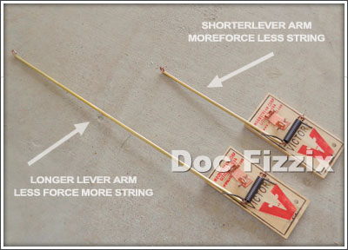
What It Is: Mechanical engineering involves making and testing machines that move.
Key Skills: Mechanical engineers use math and science to solve problems and design new things.
Where It's Used: many areas, such as building vehicles, power plants, and developing energy solutions.
Mechanical Engineering
What Will Happen?
Trying to make a mouse trap car go as far as possible can be rather difficult!
Let's look at a few examples of design changes and how it might affect your car
Another thing we can change is the length of the lever arm, or dowel, attached to the mouse trap
A short lever has more force, but spins the wheels less resulting in a shorter distance
A long lever has less force, but spins the wheels more resulting in a longer distance
Too long a lever arm = not enough force to overcome friction, especially at the start.

